Slide 1


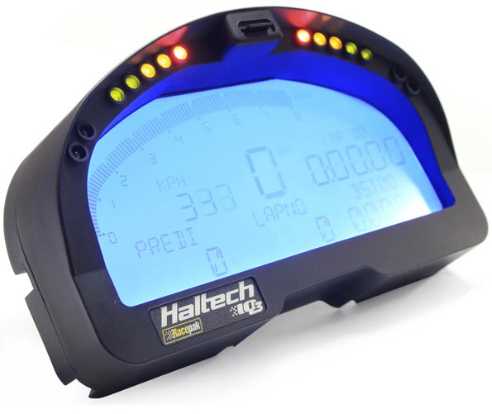

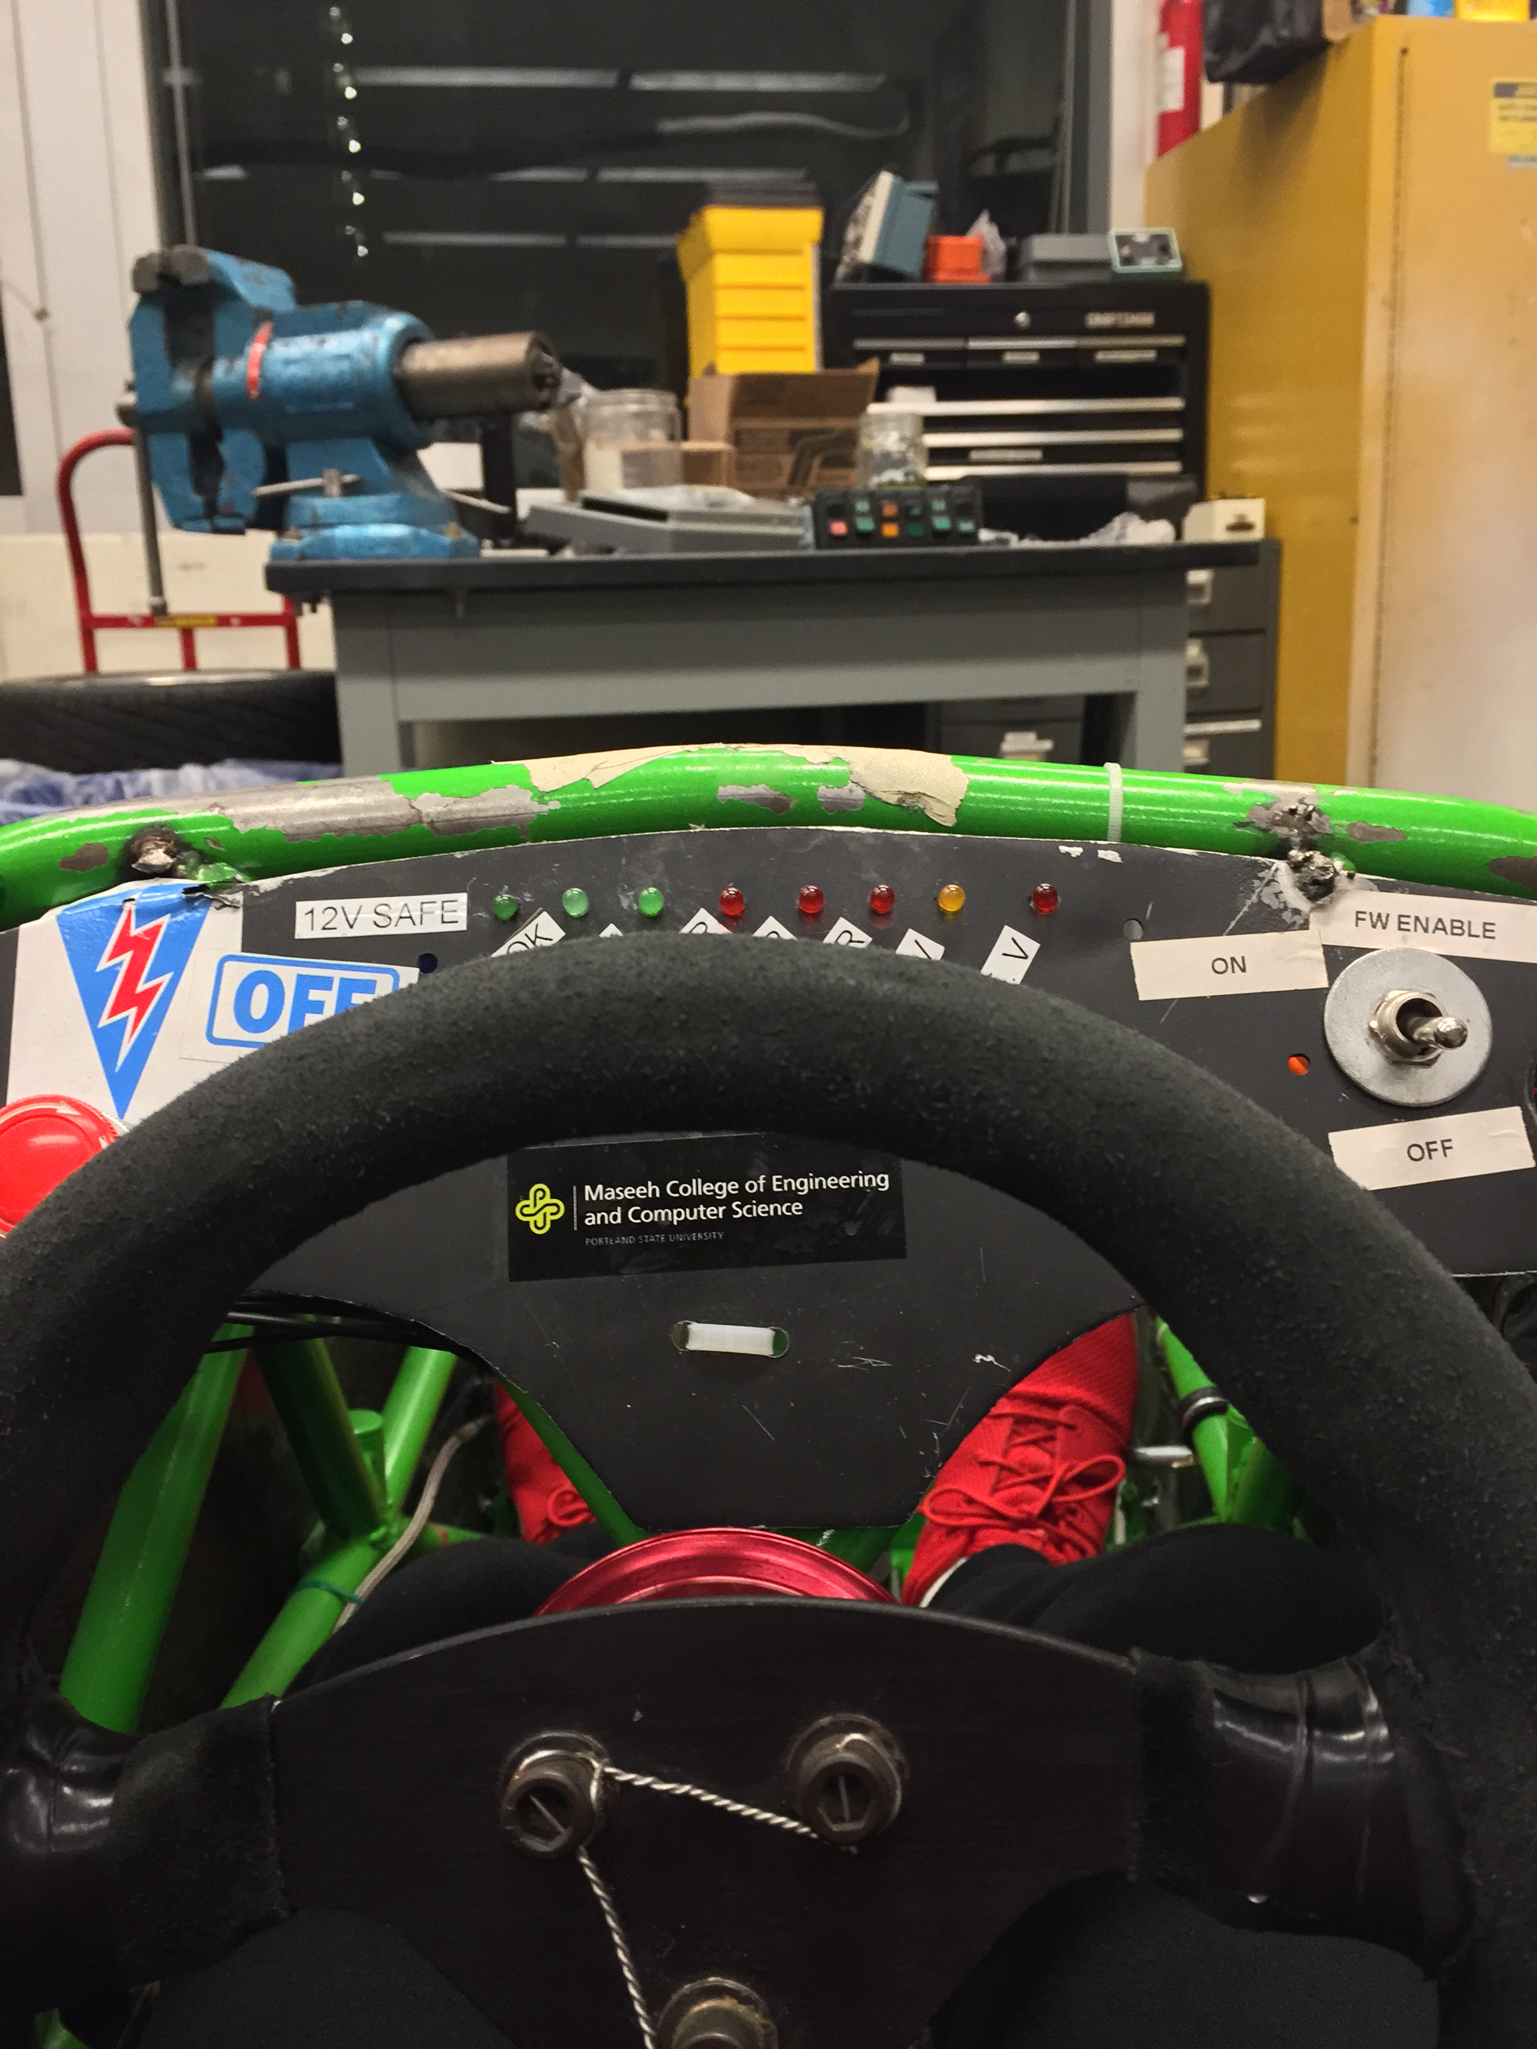
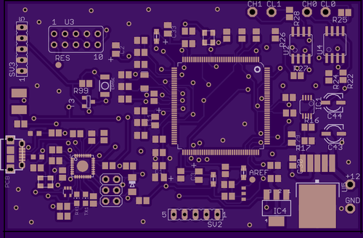
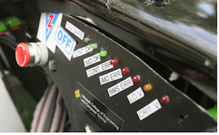
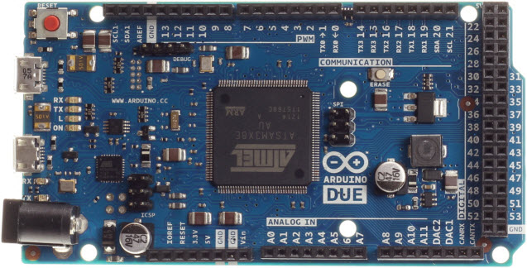
Digital Dash for SAE Electric Race Car
Prior Work
Implementation
Performance
The Viking Motorsports team could’ve chosen a number of different solutions for their digital dash. All of these solutions came at the expense of cost and would not be a custom fit for their vehicle.
CAN Transceivers
Microprocessor
Screen
Hardware
The real estate that the digital dash unit took up on the physical dash needed to be minimal. This requirement dictated two large design choices:
The 3.5” Display Size
The custom PCB to cut down size
The entire system was first prototyped using an Arduino Due which was slightly too large for the solution we had in mind. The screen was slightly smaller than the LCD and the Arduino Due would have a lot of wires plugging into the screen. We wanted our device to be as plug-and-play as possible so we created a custom PCB that would plug directly into the LCD with no “mod wires”.
Motivation
Further Improvements
Currently there is no commercially ready digital
dash unit
The digital dash can be installed on the VMS car if it works.
Screen size could be increased
Connections can be cleaned up on the custom Arduino Due to allow programing to be easier
An improved power supply could be implemented to cut down on power consumption
A cowl of some sort could be implemented to improve readability
Picture of LCD screen on Car goes here!!
Software
The software portion of the digital dash was created using the Arduino IDE. In order to interface with the CAN bus and the 4D systems screen the use of two separate Arduino libraries were used. The software sniffs the CAN bus looking for pertinent CAN messages and scales them to their correct values and sends the data to the screen.
Conclusions
Solution
In the current design of the SAE Electric Race Car, the various messages produced by the vehicle was displayed by simple LEDs. Although this method works, major issues such as a blown LED and low visibility of the LED when on could occur. These issues will prevent the driver to address any dangerous issues that the vehicle may have.
With an LCD screen integrated into the system. The driver can see all errors clearly and address them appropriately.
Screen
The 4D Systems screen came with a useful piece of software to aide the quick creation of GUIs. The screen receives values from the mainboard through a serial connection. The GUI was created to be simple and intuitive. The designed GUI also utilizes the resistive touch capability of the screen in order to flip through a couple different submenus that include further information that a driver might want.

